Slide 1
Chapter 8: Relational Database Design

Slide 2
Chapter 8: Relational Database Design
Features of Good Relational Design
Atomic Domains and First Normal Form
Decomposition Using Functional Dependencies
Functional Dependency Theory
Algorithms for Functional Dependencies
Decomposition Using Multivalued Dependencies
More Normal Form
Database-Design Process
Modeling Temporal Data

Slide 3
Think…
Which is better?
instructor(ID, name, dept name, salary)
department(dept name, building, budget)
VS
inst dept (ID, name, salary, dept name, building, budget)

Slide 4

Combine Schemas?
Suppose we combine instructor and department into inst_dept
  (No connection to relationship set inst_dept)
Result is possible repetition of information
t₁
12122, Carter, 70000, Comp.Sci, Taylor, 100000
t₂
12123, Cooper, 20000, null, null, null

Slide 5
A Combined Schema Without Repetition
Consider combining relations
  sec_class(sec_id, building, room_number) and
  section(course_id, sec_id, semester, year)
  into one relation
  section(course_id, sec_id, semester, year,
  building, room_number)
No repetition in this case

Slide 6
A Combined Schema Without Repetition
Update Anomaly (更新异常)
  A table T is subject to an update anomaly when changing a single attribute value for an entity instance or relationship instance represented in the table may require that several rows of T be updated .(e.g the department building changed,serval tuple must change)
Delete Anomaly (删除异常)
  A table T is subject to a delete anomaly when deleting some row of the table to reflect the disappearance of some instance of an entity or relationship can cause us to lose information about some instance of a different entity or relationship that we do not wish to forget.(删了不该删的)(eg. Delete instructor,department info may be deleted).

Slide 7
A Combined Schema Without Repetition
Insert Anomaly
  We cannot represent information about some entity or instance without including information about some other instance of an entity or relationship that does not exist .(e.g insert a department info without instructor)
Redundant Data （数据冗余）
  An entity instance or relationship instance represented in a table T may account for several rows of T.
why
  includes two types of information about only instructor and information about department
Normalize the relation

Slide 8
What About Smaller Schemas?
Suppose we had started with inst_dept. How would we know to split up (decompose) it into instructor and department?
Write a rule “if there were a schema (dept_name, building, budget), then dept_name would be a candidate key”
Denote as a functional dependency:
dept_name → building, budget
In inst_dept, because dept_name is not a candidate key, the building and budget of a department may have to be repeated.
  This indicates the need to decompose inst_dept
Not all decompositions are good. Suppose we decompose
employee(ID, name, street, city, salary) into
employee1 (ID, name)
employee2 (name, street, city, salary)
The next slide shows how we lose information -- we cannot reconstruct the original employee relation -- and so, this is a lossy decomposition.

Slide 9

A Lossy Decomposition(有损分解)

Slide 10
Example of Lossless-Join Decomposition
Lossless join decomposition（无损分解）
Decomposition of R = (A, B, C)
R₁ = (A, B) R₂ = (B, C)
A
B
C
A
B
B
C
α
β
1
2
A
B
α
β
1
2
1
2
A
B
r
∏_{A,B}(r)
∏_{B,C}(r)
∏_{A} (r) ∏_{B} (r)
A
B
C
α
β
1
2
A
B

Slide 11
8.2 First Normal Form
Domain is atomic if its elements are considered to be indivisible units
  Examples of non-atomic domains:
    Set of names, composite attributes
    Identification numbers like CS101 that can be broken up into parts
A relational schema R is in first normal form if the domains of all attributes of R are atomic
Non-atomic values complicate storage and encourage redundant (repeated) storage of data
  Example: Set of accounts stored with each customer, and set of owners stored with each account
  We assume all relations are in first normal form (and revisit this in Chapter 22: Object Based Databases)

Slide 12
8.2 First Normal Form
First Normal Form (1NF) 第一范式
消除重复组的办法：
方法一：（对表修平）Entering appropriate data into the empty columns of rows containing therepeating data (‘flattening’ the table). 在含有重复数据的行的空列中输入合适的数据
方法二： Placing the repeating data along with a copy of the original key attribute(s) into aseparate relation. 将重复数据移到一个独立的新关系中，同时还将原来的关键字属性也复制到这个新关系中

Slide 13
8.2 First Normal Form (Cont’d)
Atomicity is actually a property of how the elements of the domain are used.
  Example: Strings would normally be considered indivisible
  Suppose that students are given roll numbers which are strings of the form CS0012 or EE1127
  If the first two characters are extracted to find the department, the domain of roll numbers is not atomic.
  Doing so is a bad idea: leads to encoding of information in application program rather than in the database.

Slide 14
Goal — Devise a Theory for the Following
Decide whether a particular relation R is in “good” form.
In the case that a relation R is not in “good” form, decompose it into a set of relations {R₁, R₂, ..., R_{n}} such that
  each relation is in good form
  the decomposition is a lossless-join decomposition
Our theory is based on:
  functional dependencies
  multivalued dependencies

Slide 15
8.3 Decomposition Using Functional Dependencies
Constraints on the set of legal relations.
Require that the value for a certain set of attributes determines uniquely the value for another set of attributes.
A functional dependency is a generalization of the notion of a key.
关系模式中的各属性之间相互依赖、相互制约的联系称为数据依赖。
身份证号 → 姓名
学号＋课号 → 课程成绩

Slide 16
8.3.1 Functional Dependencies (Cont.)
Let R be a relation schema α ⊆ R and β ⊆ R
The functional dependency
α → β
holds on R if and only if for any legal relations r(R), whenever any two tuples t₁ and t₂ of r agree on the attributes α, they also agree on the attributes β. That is,
t₁[α] = t₂ [α] ⇒ t₁[β ] = t₂ [β ] (α取值相同， β 值也相同)
Example: Consider r(A,B ) with the following instance of r.
A(ClassNo) B(StudentNo)
On this instance, A → B does NOT hold, but B → A does hold. (但这里数据少，不明确 )
4
1 5
3 7

Slide 17

8.3.1 Keys and Functional Dependencies
Example
  A→C is satisfied
  (A取相同的值，C就相同)
  C→A is not satisfied
  (C取相同的值,A不一定相同)

Slide 18
8.3.1 Functional Dependencies (Cont.)
K is a superkey for relation schema R if and only if K → R
K is a candidate key for R if and only if
  K → R, and
  for no α ⊂ K, α → R (K的真子集不能决定R)
Functional dependencies allow us to express constraints that cannot be expressed using superkeys. Consider the schema:
inst_dept (ID, name, salary, dept_name, building, budget ).
We expect these functional dependencies to hold:
dept_name→ building
and ID → building
but would not expect the following to hold:
dept_name → salary

Slide 19
Example One
Given relation r(R) shown below, which FD is satisfied by r
  A. A →B B. AC → B C. BC →A D. B → C
A
B
C
t1
1
4
2
t2
3
5
6
t3
3
4
6
t4
7
3
8
t5
9
1
0

Slide 20
Example One (cont.)
  t2[A]=t3[A]=3, t2[B]=5 ≠ t3[B]=4,
  A →B is not satisfied
  t2[AC]=t3[AC]=36, t2[B]=5 ≠ t3[B]=4,
  AC →B is not satisfied
  BC →A is satisfied(不明确)
  t1[B]=t3[B]=4, t1[C]=2 ≠ t3[C]=6,
  B →C is not satisfied

Slide 21
Example Two
Consider the schema R=(employee_ID, date, turnover per-day, department_name, manager) that describes the information about the turnover per-day (日营业额) for each employee everyday, the department that each employee works at, and the manager of the department the employee works at.
it is assumed that
  at every day, each employee has only one turnover per-day
  each employee works at only one department
  each department is managed by only one manager
According to the descriptions mentioned above, list all the functional dependencies that hold on R

Slide 22
Example Two (cont.)
Answer
  F = { employee_ID, date → turnover per-day,
  employee_ID →department_name,
  department_name →manager
  }

Slide 23
函数依赖与属性之间的联系类型有关
在一个关系模式中，如果属性X与Y有1：1联系时，则存在函数依赖X→Y，Y→X，即X←→Y。
  例如，当学生无重名时，SNO←→SN。
如果属性X与Y有m：1的联系时，则只存在函数依赖X→Y。
  例如，SNO与AGE，DEPT之间均为m：1联系，所以有SNO→AGE，SNO→DEPT。
如果属性X与Y有m：n的联系时，则X与Y之间不存在任何函数依赖关系。
  例如，一个学生可以选修多门课程，一门课程又可以为多个学生选修，所以SNO与CNO之间不存在函数依赖关系。
由于函数依赖与属性之间的联系类型有关，所以在确定属性间的函数依赖关系时，可以从分析属性间的联系类型入手，便可确定属性间的函数依赖。

Slide 24
Use of Functional Dependencies
We use functional dependencies to:
  test relations to see if they are legal under a given set of functional dependencies.
    If a relation r is legal under a set F of functional dependencies, we say that r satisfies F.
  specify constraints on the set of legal relations
    We say that F holds on R if all legal relations on R satisfy the set of functional dependencies F.
Note: A specific instance of a relation schema may satisfy a functional dependency even if the functional dependency does not hold on all legal instances.
  For example, a specific instance of instructor may, by chance, satisfy name → ID.

Slide 25
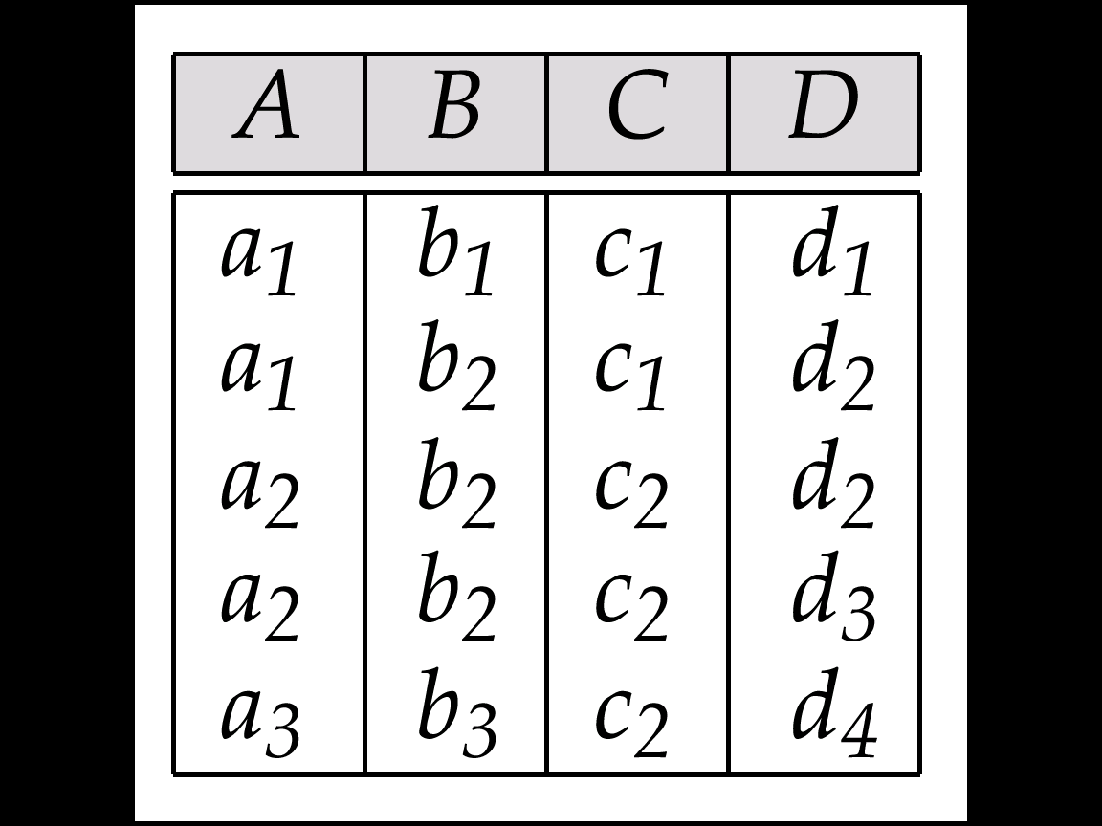
FD holds on R vs FD is satisfied by r(R)
FD₁= {A → C, AB → D}
, satisfied by r₁
FD₂= {AB → D}
, satisfied by r₂
r₁
r₂
t2
t2
b₃
b₃
a₁ | b₄ | c₂ | d₅
t6
A → C does not hold on R, because of t6
Fig.7 instance r₁ and r₂ defined on schema R

Slide 26
Functional Dependencies (Cont.)
Def. Trivial FD (平凡依赖)
A functional dependency α → β is trivial , if
for any schema R, where α⊆R, β ⊆ R, α → β is satisfied by all relations/instances r on R
or: α → β on R is trivial if it holds on any schema R, where α⊆R, β ⊆ R
X → X , XY → X,
  Example:
    ID, name → ID
    name → name
  In general, α → β is trivial if β ⊆ α
X
Y

Slide 27
Functional Dependencies (Cont.)
Def. Partial dependency (部分函数依赖)
  a functional dependency α → β is partial if there is a proper subset γ of α, i.e. γ ⊂α, such that
    γ → β
    ; and β is partially dependent on α
    /*α非最小化/冗余
E.g. Student(sno, sname, address, depart)
  for partial dependency
(sno, sname)→address
, there are sname→address, sno→address
P

Slide 28
Functional Dependencies (Cont.)
p
f
X
X
Y
Y
X’
X’
Exists X’ ⊂X
For all X’ ⊂X

Slide 29
Functional Dependencies (Cont.)
Def. Transitive dependency (传递函数依赖)
a functional dependency α → γ is transitive if:
α → β ，（ β ⊆ α ）， β → α ， β → γ
; and γ is called transitive dependent on α
E.g. Student(sno, sname, address, depart)
  for transitive dependency
  sno→address
  , there are
  sno→sname, sname→ address
T

Slide 30
Closure of a Set of Functional Dependencies
Def.Given a set F of functional dependencies, there are certain other functional dependencies that are logically implied by F.
  For example: If A → B and B → C, then we can infer that A → C
The set of all functional dependencies logically implied by F is the closure of F( F⁺⁾
Def. Given a set F of functional dependencies, the closure of F, denoted as F⁺
  F⁺ = { f | f is logically implied by F }
  e.g. in Fig. 7.0.5, {A → B , B → C }⁺
  = {A → B , B → C, A → C, … }

Slide 31
An Example of Functional Dependency
Question
Which rule about functional dependencies shown below is right
  A. if α→β then β→α
  B if A→C , BC→D then AB→D
  C. if AB→C then B→C
  D if α⊆β, then α→β
Answer: B

Slide 32
8.3.2 Boyce-Codd Normal Form
A relation schema R is in BCNF with respect to a set F of functional dependencies if for all functional dependencies in F⁺ of the form
α → β
where α ⊆ R and β ⊆ R, at least one of the following holds:
α  → β is trivial (i.e., β ⊆ α)
α is a superkey for R (only key can decide other attributes or none superkey attributs can not decide other attibutes))非关键字不能发出箭头）
Example schema not in BCNF:
instr_dept (ID, name, salary, dept_name, building, budget )
because dept_name→ building, budget(非关键字决定了其它属性)
holds on instr_dept, but dept_name is not a superkey
Example 2
STC( S, T, C) S—Student, T—Teacher, C--Course
F = { (S，C)→T, (S，T)→C, T→C }

Slide 33
Decomposing a Schema into BCNF
Suppose we have a schema R and a non-trivial dependency α →β causes a violation of BCNF.
We decompose R into:
  (α U β ) (将α 能决定的属性单独形成一个关系)
  ( R - ( β - α ) )(去掉R中能由α 决定的属性)
In our example(dept_name-> building, budget)
  α = dept_name
  β = building, budget
  and inst_dept is replaced by
  (α U β ) = ( dept_name, building, budget )
  ( R - ( β - α ) ) = ( ID, name, salary, dept_name )

Slide 34
Decomposing a Schema into BCNF
对FD集合F
T=empty; //初始化 分解结果
// 对R迭代分解
repeat
if fd=( α →β ) in F 违反BCNF
分解结果T= T ∪ {(α U β ) ，( R - ( β - α ) )}
//小关系变多
F=F-fd ; // 没有处理的fd 变少 ，F变小
R= ( R - ( β - α ) // 大关系R变小
Until F=empty.
Output T

Slide 35

8.3.3 BCNF and Dependency Preservation
In some cases, decomposition(分解) into BCNF can prevent efficient testing of certain functional dependencies.

Slide 36
BCNF and Dependency Preservation
dept_advisor (s_ID, i_ID, dept_name)
  “an instructor can act as advisor for only a single department.”
  “a student may have more than one advisor, but at most one corresponding to a given department”.
i_ID→dept_name
s_ID, dept_name→i_ID
We see that dept_advisor is not in BCNF because i_ID is not a superkey.

Slide 37
BCNF and Dependency Preservation
We see that dept_advisor is not in BCNF because i_ID is not a superkey. Following our rule for BCNF decomposition, we get:
  (s_ID, i_ID)
  (i_ID, dept_name)
However, in our BCNF design, there is no schema that includes all the attributes appearing in the functional dependency s_ID, dept_name→i_ID.
We say our design is not dependency preserving(不是保持依赖的).

Slide 38
8.3.3 BCNF and Dependency Preservation
Constraints, including functional dependencies, are costly to check in practice unless they pertain to only one relation
If it is sufficient to test only those dependencies on each individual relation of a decomposition in order to ensure that all functional dependencies hold, then that decomposition is dependency preserving.
Because it is not always possible to achieve both BCNF and dependency preservation, we consider a weaker normal form, known as third normal form.

Slide 39
8.3.4 Third Normal Form
A relation schema R is in third normal form (3NF) if for all:
α → β in F⁺
at least one of the following holds:
  α → β is trivial (i.e., β ∈ α)
  α is a superkey for R
  Each attribute A in β – α is contained in a candidate key for R.
  (NOTE: each attribute may be in a different candidate key)
If a relation is in BCNF it is in 3NF (since in BCNF one of the first two conditions above must hold).
Third condition is a minimal relaxation of BCNF to ensure dependency preservation (will see why later).

Slide 40
Third Normal Form
Each attribute A in β – α is contained in a candidate key for R.
  (NOTE: each attribute may be in a different candidate key)
例：
已知 候选关键字 A₁B_{1，} A₂B_{2，} A₃B_{3，} α=CD, β = A₁A₂A₃ D
α → β in F^{+ ，} β - α =A₁A₂A₃
则 α → β 符合 3NF规定
即允许： α → β ， α非关键字，非关键字能决定关键字的一部分属性 A₁A₂A₃
箭头只能 发到候选关键字中

Slide 41
Third Normal Form
Example R = (J, K, L), F = {JK → L, L → K}
  Two candidate keys: JK and JL
  R is in 3NF 已经是3NF
  JK → L JK is a superkey
  L → K K is contained in a candidate key
  BCNF decomposition has (JL) and (LK)
  BCNF把J和K分开了 ，所以不保持依赖 JK → L
3NF 一点冗余 因为 有一点部分依赖
example :
  Banker-schema = (branch-name, customer-name, banker-name)
  banker-name → branch name
  branch-name customer-name → banker-name

Slide 42
VII3 Normal Forms
According to functional dependencies, multivalued dependencies, and join dependencies existing in relational schemas, schemas can be classified as
  First Normal Form, 1NF
  Second Normal Form, 2NF
  Third Normal Form, 3NF
  Boyce-Codd Normal Form, BCNF
  Forth Normal Form, 4NF
  Fifth Normal Form, 5NF
Normal forms can be obtained by several decomposition algorithms on schemas

Slide 43
VII-3-1 First Normal Form (§8.2)
An attribute domain is atomic if its elements are considered to be indivisible units
Examples of non-atomic domains
  domain of multi-valued attribute
    e.g. dependent-name {{Smith}, {John, Alice}, {Johnson, Brook}}
  domain of composite attribute
    e.g identification numbers of a student, like CS101, can be broken up into parts, “CS” and “101”

Slide 44
VII-3-2 Second Normal Form
Def.1. A schema R is in second normal form (2NF) if
  R is in 1NF, and
  each attribute A in R meets one of the following criteria
    it appears in a candidate key; or
    /* A is a primary attribute */
    it is not partially dependent on a candidate key
    /* A is completely dependent on a candidate key */
Def.2. 如果关系模式R是1NF，而且每一个非主属性都完全依赖于R的主/候选键，则R为2NF

Slide 45
2NF Example
E.g. SLC(S# , SD, SL, C# , G)
  (S#, C# ) → G, SD → SL,
  S#→ SD, (S#, C# ) → SD,
S#→ SL, (S#, C# ) → SL}
SLC is not in 2NF, because
  for non-primary attribute SD, there exits S#→ SD, so SD is partially dependent on the key (S#, C# )
  for non-primary attribute SL, there exits S#→ SL, so SL is partially dependent on the key (S#, C# )

Slide 46
VII-3-3 Third Normal Form (§8.3.4)
Def.1. A relation schema R is in third normal form (3NF) with respect to a set F of functional dependencies if,
for all α → β in F⁺, at least one of the following holds
  α → β is trivial, e.g., β ⊆ α
  α is a superkey for R
  each attribute A_{i} in β – α is contained in a candidate key for R
    note: if R has several candidate keys, each attribute in β – A_{i} may be in a different candidate key
E.g. B →ABC, (ABC) – (B) =AC

Slide 47
VII-3-3 Third Normal Form (cont.)
Def.2. 如果关系模式R是2NF，而且每一个非主属性都不传递依赖于R的任何候选键，则R是3NF
If R is in 3NF, R is also in 2NF
3NF 性质
  不存在非主属性对候选键的部分和传递依赖
消除非主属性对键的传递函数依赖
2NF
3NF

Slide 48
3NF — Example One
cust_banker-branch = (customer-id, employee-id, branch-name, type)
Functional dependencies
employee-id → branch-name
/*每个雇员只能工作在一个支行
  customer-id, employee-id → branch-name, type
  customer-id, branch-name → employee-id, type
  the candidate keys:
  {customer-id, employee-id}, {customer-id, branch-name}

Slide 49
3NF — Example One (cont.)
In accordance with 3NF definition 1, cust_banker-branch is in 3NF, because
  for customer-id, branch-name → employee-id, LHS customer-id, branch-name is in the candidate key
  for employee-id → branch-name, RHS branch-name is in the candidate key
  In accordance with 3NF definition 2, cust_banker-branch is also in 3NF, because
  customer-id, employee-id and branch-name are all the primary attributes

Slide 50
3NF—Example Two
Schema SSS (S# , SD , SL)
  F_{SSS}= {S#→ SD, S#→ SL , SD→SL}
the candidate is S#
In accordance with 3NF definition1, SSS is not in 3NF, because
  for SD → SL, RHS SL in {SL}-{SD}= {SL} is not in candidate key {S#}
According to 3NF definition2, SSS is not in 3NF, because
  for S# → SL, RHS SL is non-primacy attribute, and is transitive dependent on the candidate key candidate key {S#}

Slide 51
Goals of Normalization
Let R be a relation scheme with a set F of functional dependencies.
Decide whether a relation scheme R is in “good” form.
In the case that a relation scheme R is not in “good” form, decompose it into a set of relation scheme {R₁, R₂, ..., R_{n}} such that
  each relation scheme is in good form
  the decomposition is a lossless-join decomposition
  Preferably, the decomposition should be dependency preserving.
  No redundancy（BCNF，3NF)

Slide 52
VII-3-4 BCNF (§8.3.2)
Boyce-Codd Normal Form, BCNF, enhanced 3NF
Def.1. A relation schema R is in BCNF with respect to a set F of functional dependencies, if
for all functional dependencies α → β in F⁺, where α ⊆ R and β ⊆ R, at least one of the following holds
  α  → β is trivial, e.g. β ⊆ α
  α is a superkey for R
  /* compared with 3NF
Def .2. 设R是1NF，如果对R中的每个属性（包括主属性、非主属性），不存在对键的传递或部分依赖，则R是BCNF。

Slide 53
VII-3-4 BCNF (cont.)
消除主属性对键的部分和传递函数依赖
3NF
BCNF
BCNF性质
  不存在属性（主属性，非主属性）对候选键的传递和部分依赖
If R is in BCNF, R is also in 3NF
以FD作为模式规范化程度度量，BCNF达到了最高规范化程度。如果DBS中所有模式都属于BCNF，则消除了插入和删除异常

Slide 54
How good is BCNF?
There are database schemas in BCNF that do not seem to be sufficiently normalized
Consider a relation
inst_info (ID, child_name, phone)
  where an instructor may have more than one phone and can have multiple children
ID
child_name
phone
99999
99999
99999
99999
David
David
William
Willian
512-555-1234
512-555-4321
512-555-1234
512-555-4321
inst_info

Slide 55
How good is BCNF? (Cont.)
There are no non-trivial functional dependencies and therefore the relation is in BCNF
Insertion anomalies – i.e., if we add a phone 981-992-3443 to 99999, we need to add two tuples
(99999, David, 981-992-3443)
(99999, William, 981-992-3443)

Slide 56
How good is BCNF? (Cont.)
Therefore, it is better to decompose inst_info into:
inst_child
ID
child_name
99999
99999
99999
99999
David
David
William
Willian
inst_phone
ID
phone
99999
99999
99999
99999
512-555-1234
512-555-4321
512-555-1234
512-555-4321
This suggests the need for higher normal forms, such as Fourth Normal Form (4NF), which we shall see later.

Slide 57
8.4 Functional-Dependency Theory
We now consider the formal theory that tells us which functional dependencies are implied logically by a given set of functional dependencies.
We then develop algorithms to generate lossless decompositions into BCNF and 3NF
We then develop algorithms to test if a decomposition is dependency-preserving

Slide 58
Closure of a Set of Functional Dependencies
Given a set F set of functional dependencies, there are certain other functional dependencies that are logically implied by F.
  For e.g.: If A → B and B → C, then we can infer that A → C
The set of all functional dependencies logically implied by F is the closure of F.(能被F推出的一切fd的集合称为 closure of F. 记为 F⁺ )
We denote the closure of F by F⁺.

Slide 59
Closure of a Set of Functional Dependencies
We can find F^{+,} the closure of F, by repeatedly applying
Armstrong’s Axioms:
  if β ⊆ α, then α → β (reflexivity)
  if α → β, then γ α → γ β (augmentation)
  if α → β, and β → γ, then α → γ (transitivity)
These rules are
  sound (generate only functional dependencies that actually hold,可靠的), and
  complete (generate all functional dependencies that hold).
  All valid rules of implication among FDs can be derived from Armstrong’s Axiom.

Slide 60
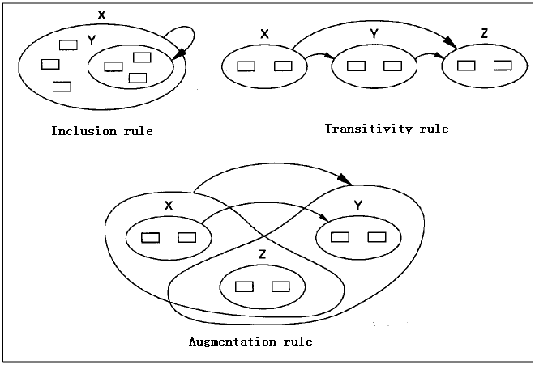
Armstrong’s Axioms:

Slide 61
Closure of Functional Dependencies (Cont.)
Additional rules:
  If α → β holds and α → γ holds, then α → β γ holds (union)
  If α → β γ holds, then α → β holds and α → γ holds (decomposition)
  If α → β holds and γ β → δ holds, then α γ → δ holds (pseudotransitivity)
  The above rules can be inferred from Armstrong’s axioms.

Slide 62
Armstrong’s Axioms:
Some implications of Armstrong’s Axiom
  [1] Union rule(合并规则): if X → Y and X →Z, then X → YZ
  [2] Decomposition rule(分解规则): if X → YZ, then X → Y and X → Z
  [3] Pseudotransitivity rule(伪传递规则): if X → Y and WY →Z, then XW → Z
  [4] Set accumulation rule(集合累积规则): if X →YZ and Z →W, then X→ YZW

Slide 63
Closure of a Set of Functional Dependencies
  Given a set F of FDs on attributes of a table T, we define the closure of F, symbolized by F⁺, to be the set of all FDs implied by F(F所蕴含的全部函数依赖).
If A → B and B → C 成立）then A → C（成立）
基本的（核心） 派生的（也在闭包中）
能推出的一切fd的集合称为 closure of F. 记为 F⁺.
以F 为基础，
使用 反、加、传、伪、并、 分 等 一切手段

Slide 64
Procedure for Computing F⁺
To compute the closure of a set of functional dependencies F:
F ⁺ = F
repeat
for each functional dependency f in F⁺
apply reflexivity and augmentation rules on f
add the resulting functional dependencies to F ⁺
for each pair of functional dependencies f₁and f₂ in F ⁺
if f₁ and f₂ can be combined using transitivity
then add the resulting functional dependency to F ⁺
until F ⁺ does not change any further
NOTE: We shall see an alternative procedure for this task later
1 用反射和增广 滚雪球
2 用传递
滚雪球
直到 不能 再增加

Slide 65
Example
R = (A, B, C, G, H, I)
F = { A → B
A → C
CG → H
CG → I
B → H}
some members of F⁺
  A → H
    by transitivity from A → B and B → H
  AG → I
    by augmenting A → C with G, to get AG → CG
    and then transitivity with CG → I
  CG → HI
    by augmenting CG → I to infer CG → CGI,
    and augmenting of CG → H to infer CGI → HI,
    and then transitivity

Slide 66
Closure of Attribute Sets
Given a set of attributes α, define the closure of α under F (denoted by α⁺) as the set of attributes that are functionally determined by α under F α → β is in F⁺ ⬄ β ⊆ α⁺ (由 α 通过F 可以搞定的那些β的集合称为α 的闭包)
{β | β is functionally determined by α under F}
  β is functionally determined by α under F , if and only if α → β ∈ F⁺
E.g. R(A, B, C, D) and F={A → B, B → C}
  F⁺= {A → B, B → C, A → C, …}
  (A) ⁺= (ABC)， A → ABC ∈ F⁺

Slide 67
Closure of Attributes (cont.)
  Input: α , F
Output: α ⁺
result := α ;
while (changes to result) do
for each β → γ in F do
begin
if β ⊆ result /* result =(β, …)
then result := result ∪ γ
end
判断计算属性的闭包何时可以停止，以下三种方法是等价的：
（1）在F中函数依赖的右边再也找不到α^{(i)}中未出现过的属性，即α^{(i+1)} = α^{(i)}
（2）当发现α^{(i)}包含了全部属性时；
（3）在F中已没有未用过的左边属性为α^{(i)}的子集的函数依赖。
Fig.7.9 An efficient algorithm to compute α⁺ under F

Slide 68
Example of Attribute Set Closure
R = (A, B, C, G, H, I)
F = {A → B
A → C
CG → H
CG → I
B → H}
(AG)⁺
  1. result = AG
  2. result = ABCG (A → C and A → B)
  3. result = ABCGH (CG → H and CG ⊆ AGBC)
  4. result = ABCGHI (CG → I and CG ⊆ AGBCH)
Is AG a candidate key?
  Is AG a super key?
    Does AG → R? (AG)⁺
  Is any subset of AG a superkey?
    Does A → R? (A)⁺ (A →ABCH) No
    Does G → R? (G)⁺ (G →) No

Slide 69
Uses of Attribute Closure
There are several uses of the attribute closure algorithm:
Testing for superkey:(测试超码)
  To test if α is a superkey, we compute α^{+,} and check if α⁺ contains all attributes of R. (R = α ⁺)
Testing functional dependencies(测试FD)
  To check if a functional dependency α → β holds (or, in other words, is in F⁺), just check if β ⊆ α⁺.
  That is, we compute α⁺ by using attribute closure, and then check if it contains β.
  Is a simple and cheap test, and very useful
Computing closure of F
  For each γ ⊆ R, we find the closure γ⁺, and for each S ⊆ γ⁺, we output a functional dependency γ → S.

Slide 70
Computing of Candidate Keys
定理。如果属性A只出现在F中函数依赖的左部, 则A一定是主属性, 必然出现在候选键中
输入：关系模式R及其函数依赖集F
输出：R的所有候选关键字
方法：
  step1.将R的所有属性分为四类：
    L类：仅出现在F中函数依赖左部的属性
    R类：仅出现在F中函数依赖右部的属性
    N类：在F中函数依赖左右两边均未出现的属性
    LR类：在F中函数依赖左右两边均出现的属性

Slide 71
Computing of Candidate Keys (cont.)
step1:并令X_set代表L、N类，Y_set代表LR类；
step2. 求X_set ^{+，}若包含了R的所有属性，则X_set即为R的唯一候选关键字，转step5；否则转step3
step3. 在Y_set中取一属性A，求（X _set A)⁺,若它包含了R的所有属性，则转step4;
  否则，调换一属性反复进行这一过程，直到试完所有Y_set中的属性
step4. 如果已找出所有的候选关键字，则转step5;
  否则，在Y_set中依此取两个、三个，…，求他们的属性闭包，直到其闭包包含R的所有的属性
step5. 停止，输出结果

Slide 72
Computing of Candidate Keys (cont.)
E.g. 1 R(X, Y, Z, W), and F = {X→Z, Z→X, Y→XZ, W→XZ}
  L：Y, W
  R、N: None
  LR: X, Z
  X_set={Y, W}
  Y_set={X, Z}
  (YW)⁺=R, so YW is the candidate key

Slide 73
Computing of Candidate Keys (cont.)
E.g.2. R(B, D, I, O, Q, S), and
F = {B→Q, I→S, IS→Q, S→D}
  L：B, I
  R：D, Q
  N: O
  LR: S
  X_set={B, I, O}
  Y_set={S}
  (BIO)⁺=R, so BIO is candidate key

Slide 74
Canonical Cover(规范或正则覆盖)
Sets of functional dependencies may have redundant dependencies that can be inferred from the others
  For example: A → C is redundant in: {A → B, B → C, A→ C}
  Parts of a functional dependency may be redundant
    E.g.: on RHS: {A → B, B → C, A → CD} can be simplified to
    {A → B, B → C, A → D} // A→C,A→D A→CD
    E.g.: on LHS: {A → B, B → C, AC → D} can be simplified to
    {A → B, B → C, A → D}
    F A→C A→AC(AC→D) A→D
Intuitively, a canonical cover of F is a “minimal” set of functional dependencies equivalent to F, having no redundant dependencies or redundant parts of dependencies
冗余的函数依赖！
(无关)冗余的属性！

Slide 75
Extraneous(多余/无关) Attributes
Consider a set F of functional dependencies and the functional dependency α → β in F.
  Attribute A is extraneous in α if A ∈ α
  and F logically implies (F – {α → β}) ∪ {(α – A) → β}.
  Attribute A is extraneous in β if A ∈ β
  and the set of functional dependencies
  (F – {α → β}) ∪ {α →(β – A)} logically implies F.
Note: implication in the opposite direction is trivial in each of the cases above, since a “stronger” functional dependency always implies a weaker one
A在箭尾α(左)中是多余的——没有它，靠F中其他的也能推出其余规律
A在箭头β(右)中是多余的——没有它，靠其他的也能推出F

Slide 76
Extraneous(多余/无关) Attributes
Example: Given F = {A → C, AB → C }(B在箭尾/左边)
  B is extraneous in AB → C because {A → C, AB → C} logically implies A → C (I.e. the result of dropping B from AB → C).
Example: Given F = {A → C, AB → CD}(C在箭头/右边)
  C is extraneous in AB → CD since AB → C can be inferred even after deleting C

Slide 77
Testing if an Attribute is Extraneous
Consider a set F of functional dependencies and the functional dependency α → β in F.
To test if attribute A ∈ α is extraneous in α ( 测试A是否为左部无关属性 , α中去除A后是否能→ β )
  compute ({α} – A)⁺ using the dependencies in F
  check that ({α} – A)⁺ contains β; if it does, A is extraneous in α
  To test if attribute A ∈ β is extraneous in β (测试A是否为右部无关属性 )
  compute α⁺ using only the dependencies in
  F’ = (F – {α → β}) ∪ {α →(β – A)} ( delete α → β, add α →(β – A) ){A →BC,A →B,B →C}
  check that α⁺ contains A; if it does, A is extraneous in β

Slide 78
Canonical Cover
A canonical cover for F is a set of dependencies F_{c} such that
  F logically implies all dependencies in F_{c,} and
  F_{c} logically implies all dependencies in F, and
  No functional dependency in F_{c} contains an extraneous attribute, and Each left side of functional dependency in F_{c} is unique.
  F及F_{C}具有相同的闭包，而F_{C}是最小的，每个FD不含无关属性,每个FD的左边是唯一的。

Slide 79
Canonical Cover
To compute a canonical cover for F:
repeat
Use the union rule to replace any dependencies in F（同左合并,减少FD个数)
α₁ → β₁ and α₁ → β₂ with α₁ → β₁ β₂
Find a functional dependency α → β with an (删除箭头、箭尾的多余属性)
extraneous attribute either in α or in β
/* Note: test for extraneous attributes done using F_{c,} not F* Fc 指当前时刻的函数依赖集 /
If an extraneous attribute is found, delete it from α → β
until F does not change
Note: Union rule may become applicable after some extraneous attributes have been deleted, so it has to be re-applied（精简 箭尾 多余 属性后， 还可能再用并)

Slide 80
F, F⁺, and F_{C}
F⁺ = F_{c}⁺
F_{C}
shrink
grow
F⁺
F

Slide 81
Computing a Canonical Cover
R = (A, B, C)
F = {A → BC
B → C
A → B
AB → C}
1) Combine A → BC and A → B into A → BC
  Set is now {A → BC, B → C, AB → C} ---当前Fc
2) A is extraneous in AB → C ( α 方, 判断：B⁺关于F_{c,}的闭包是否包含C？Yes)
  Check if the result of deleting A from AB → C is implied by the other dependencies
    Yes: in fact, B → C is already present!
  Set is now {A → BC, B → C} ---当前Fc
3) C is extraneous in A → BC
( β方,判断：A⁺关于F’= {A → B, B → C}的闭包是否包含C？Yes)
  Check if A → C is logically implied by A → B and the other dependencies
    Yes: using transitivity on A → B and B → C.
      Can use attribute closure of A in more complex cases
  The canonical cover is: {A → B，B → C} ---当前Fc
如何计算F的正则覆盖Fc ?

Slide 82
函数依赖集的最小集
一、函数依赖最小集定义
对于给定的一个函数依赖集F，当满足下列条件时，则称为F的最小函数依赖集，或者称为F的最小集，记为F’ 。
（1）F’的每个函数依赖的右部都是单个属性；
（2）对于F’的任一函数依赖X→A来说，
F’-{X→A}与F’都不等价，
保证了在F中不存在多余的函数依赖；
（3）对于F’的任一函数依赖X→A来说，
(F’-{X→A})∪{Z→A}与F’都不等价，
其中，Z为X的任一子集，
保证了F中的每个函数依赖的左边没有多余的属性。

Slide 83
函数依赖集的最小集
定理1：每个函数依赖集F都与它的最小函数依赖集F’等价。
二、F的最小依赖集求解算法
（1）用分解规则将F中所有依赖变为右边都是单属性的依赖。
（2）去掉F中多余的依赖。
对每个依赖X→A，在F-{X→A}中求X⁺，若A∈X⁺，则X→A多余，去掉。
（3）去掉各依赖左边的多余属性。
对每个左边为多属性的依赖，如XY→A，在F中求X⁺，若A∈X⁺，则Y是多余属性，用X→A代替XY→A。

Slide 84
函数依赖集的最小集
例：已知F={AB→C,C→A,BC→D,ACD→B,D→EG, BE→C, CG→BD, CE→AG},求F’。
解：
(1) 用分解规则，将F中所有函数依赖变为右边都是单属性的依赖，得F1={AB→C,C→A,BC→D,ACD→B,D→E,D→G, BE→C, CG→B ,CG→D, CE→A,CE→G}
(2) 去掉F1中多余的函数依赖。
X→A 在F1-{X→A}中求X⁺ 判断A∈X⁺是否成立
ABC (AB)⁺=AB C ∉{A,B}
CA (C)⁺=C A ∉{C}
BCD (BC)⁺=BCA D ∉{BCA}
ACDB (ACD)⁺=ACDEGB B ∈{ACDEGB}
delete ACDB

Slide 85
F1={AB→C,C→A,BC→D, D→E,D→G, BE→C, CG→B,CG→D, CE→A,CE→G}
DE (D)⁺=DG E ∉{DG}
DG (D)⁺=DE G∉{DE}
BEC (BE)⁺=BE C∉{BE}
CGB (CG)⁺=CGADE B∉{CGADE}
CGD (CG)⁺=CGABDE D∈{CGABDE}
delete CGD
F1={AB→C,C→A,BC→D, D→E,D→G, BE→C, CG→B, CE→A,CE→G}
CEA (CE)⁺=CEAGBD A ∈{CEAGBD}
delete CEA
F1={AB→C,C→A,BC→D, D→E,D→G, BE→C, CG→B, CE→G}
CEG (CE)⁺=CEA G∉{CEA}

Slide 86
经上述计算，得：F2={AB→C,C→A,BC→D, D→E,D→G, BE→C, CG→B, CE→G}
(3) 去掉F2中函数依赖左边的多余属性。
对AB→C，在F2中分别计算：
对A，求B⁺=B，C ∉ B⁺，∴A不是多余属性。
对B，求A⁺=A，C ∉ A⁺，∴B不是多余属性。
对BC→D，在 F2中分别计算：
对B，求C⁺=AC，D ∉ C⁺，∴B不是多余属性。
对C，求B⁺=B，D ∉ B⁺，∴ C不是多余属性。
对BE→C，在 F2中分别计算：
对B，求E⁺… …
对E，求B⁺… …
… …
最终F2中函数依赖的左边无多余属性。
∴ F2即为F的最小函数依赖集。
注意：F的最小函数依赖集不是唯一的，与对各函数依赖及其左边各属性的处置顺序有关。例若步骤(2)先考虑CG→B，结果会不一样。

Slide 87
模式分解中存在的问题
{A → B, B → C}
A | B | C
a1 | b1 | c1
a2 | b1 | c1
a3 | b2 | c2
a4 | b3 | c1
Loss B->C
{A → B}
{A → C}
A | B
a1 | b1
a2 | b1
a3 | b2
a4 | b3
a5 | b3
A | C
a1 | c1
a2 | c1
a3 | c2
a4 | c1
a5 | c3
A | B | C
a1 | b1 | c1
a2 | b1 | c1
a3 | b2 | c2
a4 | b3 | c1
a5 | b3 | c3
=
违反B→C
插入

Slide 88
{A → C}
{B → C}
A | B | C
a1 | b1 | c1
a1 | b3 | c1
a2 | b1 | c1
a2 | b3 | c1
a3 | b2 | c2
a4 | b1 | c1
a4 | b3 | c1
A | C
a1 | c1
a2 | c1
a3 | c2
a4 | c1
B | C
b1 | c1
b2 | c2
b3 | c1
违反A→B
=
{A → B}
{ B → C}
A | B
a1 | b1
a2 | b1
a3 | b2
a4 | b3
B | C
b1 | c1
b2 | c2
b3 | c1
A | B | C
a1 | b1 | c1
a2 | b1 | c1
a3 | b2 | c2
a4 | b3 | c1
=

Slide 89
Lossless Decomposition
Def. The decomposition {R₁, R₂, ..., R_{n}} of R is lossless decomposition (无损分解) if ,
for all possible relations r(R) in legal database instances,
r = ∏_{R1} (r) ∏_{R2} (r) ... ∏_{Rn} (r)
  also known as lossless-join (无损连接分解) decomposition
/*无损连接分解中，R所对应的r被分成若干垂直片段∏_{Ri} (r) , 各垂直片段通过自然连接可恢复r中的数据，保证了数据的完整性/分解可恢复性,不一定能解决插入异常，删除异常等
Def. Lossy decom position /*有损连接分解*/
r ≠ ∏_{R1} (r) ∏_{R2} (r) ... ∏_{Rn} (r)
  also known as lossy-join (有损连接分解) decomposition
Lossy decompositions may result in information loss

Slide 90
Lossless-join Decomposition
For the case of R = (R₁, R₂), we require that for all possible relations r on schema R
r = ∏_{R1} (r ) ∏_{R2} (r )
A decomposition of R into R₁ and R₂ is lossless join if at least one of the following dependencies is in F⁺:
  R₁ ∩ R₂ → R₁
  R₁ ∩ R₂ → R₂
The above functional dependencies are a sufficient condition for lossless join decomposition; the dependencies are a necessary condition only if all constraints are functional dependencies
分解后的关系应保存原来FD中箭头左边的属性，即某些决定因素)

Slide 91

Example
R = (A, B, C)
F = {A → B, B → C)
  Can be decomposed in two different ways
R₁ = (A, B), R₂ = (B, C)
  Lossless-join decomposition:
  R₁ ∩ R₂ = {B} and B → BC
  Dependency preserving
R₁ = (A, B), R₂ = (A, C)
  Lossless-join decomposition:
  R₁ ∩ R₂ = {A} and A → AB
  Not dependency preserving
  (cannot check B → C without computing R₁ R₂)
  分解后B → C ,B的决定作用没有了（无损不保依）

Slide 92
Dependency Preservation
Let F_{i} be the set of dependencies F ⁺ that include only attributes in R_{i}.
  A decomposition is dependency preserving, if
    (F₁ ∪ F₂ ∪ … ∪ F_{n} )⁺ = F ⁺
  If it is not, then checking updates for violation of functional dependencies may require computing joins, which is expensive.
  对R进行分解后，不会丧失R中原有的属性间的依赖关系, 但某些显示的依赖可能转换为F⁺中隐式的依赖
  /*将在R上检查全部的F是否成立转换为在各个子模式R_{i}上检查各自的F_{i}

Slide 93
Testing for Dependency Preservation
To check if a dependency α → β is preserved in a decomposition of R into R₁, R₂, …, R_{n} we apply the following test (with attribute closure done with respect to F)
  result = α
  while (changes to result) do
  for each R_{i} in the decomposition
  t = (result ∩ R_{i})⁺ ∩ R_{i} //(result∩Ri) ⁺表示result∩Ri的闭包
  result = result ∪ t //将α 投影到R_{i,} 判断R_{i}是否保持
  If result contains all attributes in β, then the functional dependency α → β is preserved.
We apply the test on all dependencies in F to check if a decomposition is dependency preserving
This procedure takes polynomial time, instead of the exponential time required to compute F⁺ and (F₁ ∪ F₂ ∪ … ∪ F_{n})⁺

Slide 94
Example
R = (A, B, C )
F = {A → B
B → C}
Key = {A}
R is not in BCNF
Decomposition R₁ = (A, B), R₂ = (B, C)
  R₁ and R₂ in BCNF
  Lossless-join decomposition
  Dependency preserving

Slide 95
Example of Dependency Preserving
Student(sno, dept, head),
F = {sno→dept, dept→head}, F⁺ = F ∪{sno→ head}
Decomposition 1
R₁(sno, dept), F₁={sno→ dept}
R₂(sno, head), F₂ ={sno → head}
  lossless, because
    R₁ ∩ R₁={sno}, and is the key of R₁ and R₂
  non-dependency preservation(不保依), because(
    (F₁ ∪ F₂) ⁺ ≠ F⁺, dept → head is lost,

Slide 96
Example of Dependency Preserving (cont.)
    for dept →head in F, 求属性闭包
    (1) with respect to R₁ // R₁(sno, dept)
    result=(dept∩ R₁)⁺∩ R₁ = {dept}⁺ ∩ {sno, dept}
    = {dept, head} ∩ {sno, dept}
    = {dept} ;
    (2) with respect to R₂ // R₂(sno, head),
    result=(dept∩ R₂)⁺∩ R₂
= φ⁺ ∩ {sno, head}= φ
dept→head is not preserved

Slide 97
Example of
Dependency Preserving (cont.)
Decomposition 2
R₁(sno, dept), F₁={sno→ dept}
R₂(dept, head), F₂ ={dept→ head}
  lossless-join, because
    R₁ ∩ R₂={dept}, and is the key of R₂
  dependency preservation, because
    ( F₁ ∪ F₂ ) ⁺ = F⁺

Slide 98
Testing for BCNF
To check if a non-trivial dependency α →β causes a violation of BCNF
  1. compute α⁺ (the attribute closure of α), and
  2. verify that it includes all attributes of R, that is, it is a superkey of R.
Simplified test: To check if a relation schema R is in BCNF, it suffices to check only the dependencies in the given set F for violation of BCNF, rather than checking all dependencies in F⁺.
  If none of the dependencies in F causes a violation of BCNF, then none of the dependencies in F⁺ will cause a violation of BCNF either.

Slide 99
Testing for BCNF
However, simplified test using only F is incorrect when testing a relation in a decomposition of R
  Consider R = (A, B, C, D, E), with F = { A → B, BC → D}
    Decompose R into R₁ = (A,B) and R₂ = (A,C,D, E)
    Neither of the dependencies in F contain only attributes from
    (A,C,D,E) so we might be mislead into thinking R₂ satisfies BCNF.
    In fact, dependency AC → D in F⁺ shows R₂ is not in BCNF.
分解后的关系不能用简单测试法则。

Slide 100
Review：Boyce-Codd Normal Form BCNF
Defintion:A relation schema R is in BCNF with respect to a set F of functional dependencies if for all functional dependencies in F⁺ of the form α → β, where α ⊆ R and β ⊆ R, at least one of the following holds:（模式R称为满足BCNF,如果 形如 α  → β 的FD至少满足下列条件之一）：
(1) α  → β is trivial (i.e., β ⊆ α) //箭头发向内部，平凡
(2) α is a superkey for R
直观解释 ：发出箭头的必是关键字，
逆否命题：非关键字不许发出箭头 。关键字法则

Slide 101
Testing Decomposition for BCNF
To check if a non-trivial dependency α →β causes a violation of BCNF
检查 α →β 是否违反了关键字法则，看α是否关键字
  1. compute α⁺ (the attribute closure of α), and
  2. 检查 α⁺ 是否包含 R.
test:
给定R和 R上的F，检查R是否在F下为 BCNF, 只须对F中的 FD 检查 法则，
不需对F+中检查 ，注意F+ 和F的差别是指数级

Slide 102
Testing Decomposition for BCNF
给定R和 R上的F，检查R是否 BCNF, 只须对F中的 FD 检查 关键字法则，不需对F⁺中检查
但是当F不是R上的FD, 而是更大的关系的FD,(分解时，总关系的FD)，只对F中元素检查关键字法则就不对
  E.g. Consider R (A, B, C, D), with F = { A →B, B →C} 这个F是分解前 总关系的F
    Decompose R into R₁(A,B) and R₂(A,C,D)
    Neither of the dependencies in F contain only attributes from (A,C,D) so we might be mislead into thinking R₂ satisfies BCNF.
    A → C in F⁺ 在 R₂ 中违反了关键字法则.

Slide 103
Testing Decomposition for BCNF
To check if a relation R_{i} in a decomposition of R is in BCNF,
  Either
  1) test R_{i} for BCNF with respect to the restriction of F to R_{i} (that is, all FDs in F⁺ that contain only attributes from R_{i})
  Or
  2) use the original set of dependencies F that hold on R, but with the following test:
  for every set of attributes α ⊆ R_{i}, check that α⁺ (the attribute closure of α)
      either includes no attribute of R_{i}- α,
      or includes all attributes of R_{i}.
  If the condition is violated by some α → β in F, the dependency
  α → (α⁺ - α ) ∩ R_{i}
  can be shown to hold on R_{i}, and R_{i} violates BCNF.α能决定的属性出现在Ri中
  We use above dependency to decompose R_{i}
要么α为R_{i} 的键, 从而Ri为BCNF
即：要么α→α⁺为R_{i} 平凡函数依赖,
这时α不是R_{i}的键，函数依赖又不是R_{i}的平凡函数依赖

Slide 104
BCNF Decomposition Algorithm
思想：R=(X Y Z) 如果R 不是BCNF, 则必有某个FD（例如X→Y） 违反了 关键字法则,
即X不是关键字，又发出了箭头 （X→Y)，（部分依赖）
X在R 中能够支配 一部分属性( Y ),
解决办法：分出去，让X 在小关系 R1 当关键字
R→ { R1, R2 }
R1=XY R2=XZ =R - R1 (分出小关系后的剩下部分）

Slide 105
BCNF Decomposition Algorithm
result := { };结果应是若若干个小关系的集合，目前(开始)是空
done := false; Remain =R,
compute F⁺;
while (not done) do
if ( Remain is not in BCNF)
then begin
if α  → β 违反了关键字法则,
Let R_{i} = α β ；
result := result ∪ (α, β );
Remain=(R- R_{i} ) ∪α; 把已检查的去掉，剩下的渐小
end
else done := true;
Note: each R_{i} is in BCNF, and decomposition is lossless-join.
剩下部分还不是BCNF
逐个检查FD是否违反了关键字法则，是则分出去

Slide 106
Example of BCNF Decomposition 1
R = (A, B, C ) (教师号，所属院系，院系地点)
F = {A → B ， B → C} Key = {A}
R is not in BCNF (B → C but B is not superkey)
Decomposition 1
  R₁ = (B, C) R₂ = (A,B)
  Lossless-join decomposition: 无损
  Dependency preserving 保依
Decomposition 2
  R₁ = (A, C) R₂ = (A,B)
  Lossless-join decomposition: 无损
  Not dependency preserving 不保依
  (cannot check B → C without computing R₁ R₂

Slide 107
Example of BCNF Decomposition 2
class (course_id, title, dept_name, credits, sec_id, semester, year, building, room_number, capacity, time_slot_id)
Functional dependencies:
  course_id→ title, dept_name, credits
  building, room_number→capacity
  course_id, sec_id, semester, year→building, room_number, time_slot_id
A candidate key {course_id, sec_id, semester, year}.
BCNF Decomposition:
  course_id→ title, dept_name, credits holds (部分依赖)
    but course_id is not a superkey.
  We replace class by:
    course(course_id, title, dept_name, credits)
    class-1(course_id, sec_id, semester, year, building,
    room_number, capacity, time_slot_id)

Slide 108
BCNF Decomposition 2
course is in BCNF
  How do we know this?
building, room_number→capacity holds on class-1
  but {building, room_number} is not a superkey for class-1.
  We replace class-1 by:
    classroom (building, room_number, capacity)
    section (course_id, sec_id, semester, year, building, room_number, time_slot_id)
classroom and section are in BCNF.

Slide 109
Example of BCNF Decomposition 3
R(ABCDEG)
ρ= { }
F = { D→G, CD→E, E→D, A→B }
删除
候选码: ACE, ACD
E不含候选码, E和D不相交
ACE→D是部分依赖
R不是BCNF
R₁(ED)
R₂(ABCEG)
F₁ = {E→D}
F₂ = {E→G, A→B }
候选码: E
候选码: ACE

Slide 110
Example of BCNF Decomposition 3
R(ABCDEG)
F = { D→G, CD→E, E→D, A→B }
候选码: ACE, ACD
ρ= { }
R₁(ED)
R₂(ABCEG)
F₁ = {E→D}
F₂ = {E→G, A→B }
候选码: E
候选码: ACE
E不含候选码,
E和G不相交
存在传递依赖ACE→G (ACE→E, E→G)
R₂不是BCNF

Slide 111
Example of BCNF Decomposition 3
R(ABCDEG)
F = { D→G, CD→E, E→D, A→B }
候选码: ACE, ACD
R₁(ED)
R₂(ABCEG)
F₁ = {E→D}
F₂ = {E→G, A→B }
候选码: E
候选码: ACE
A不含候选码,
A和B不相交
R₃(EG)
R₄(ABCE)
F₃ = {E→G}
F₄ = {A→B}
候选码: E
候选码: ACE
存在传递依赖ACE→B (ACE→A, A→B)
R₄不是BCNF

Slide 112
Example of BCNF Decomposition 3
R(ABCDEG)
F = { D→G, CD→E, E→D, A→B }
候选码: ACE, ACD
R₁(ED)
R₂(ABCEG)
F₁ = {E→D}
F₂ = {E→G, A→B }
候选码: E
候选码: ACE
A不含候选码,
A和B不相交
R₃(EG)
R₄(ABCE)
F₃ = {E→G}
F₄ = {A→B}
候选码: E
候选码: ACE
R₆(ACE)
删除
R₅(AB)
F₅ = {A→B}
F₆ = { }
候选码: A
候选码: ACE
ρ= { R₁(ED), R₃(EG), R₅(AB), R₆(ACE) }
Π_{Ri}(F):
{E→D}
{E→G}
{A→B}
{ }
候选码:
E
E
A
ACE

Slide 113
BCNF and Dependency Preservation
It is not always possible to get a BCNF decomposition that is
dependency preserving
R = (J, K, L )
F = {JK → L
L → K }
Two candidate keys = JK and JL
R is not in BCNF
Any decomposition of R will fail to preserve
JK → L
This implies that testing for JK → L requires a join

Slide 114
Third Normal Form: Motivation
There are some situations where
  BCNF is not dependency preserving, and
  efficient checking for FD violation on updates is important
Solution: define a weaker normal form, called Third Normal Form (3NF)
  Allows some redundancy (with resultant problems; we will see examples later)
  But functional dependencies can be checked on individual relations without computing a join.
  There is always a lossless-join, dependency-preserving decomposition into 3NF.

Slide 115
Third Normal Form (Review)
Def.1. A relation schema R is in third normal form (3NF) with respect to a set F of functional dependencies if,
for all α → β in F⁺, at least one of the following holds
  α → β is trivial, e.g., β ⊆ α
  α is a superkey for R
  each attribute A_{i} in β – α is contained in a candidate key for R(A是主属性）
    note: if R has several candidate keys, each attribute in β – A_{i} may be in a different candidate key
E.g. B →ABC, (ABC) – (B) =AC

Slide 116
3NF Example
Relation dept_advisor:
  dept_advisor (s_ID, i_ID, dept_name)
  F = {s_ID, dept_name → i_ID, i_ID → dept_name}
  Two candidate keys: s_ID, dept_name, and i_ID, s_ID
  R is in 3NF
    s_ID, dept_name → i_ID s_ID
      dept_name is a superkey
    i_ID → dept_name
      dept_name is contained in a candidate key

Slide 117
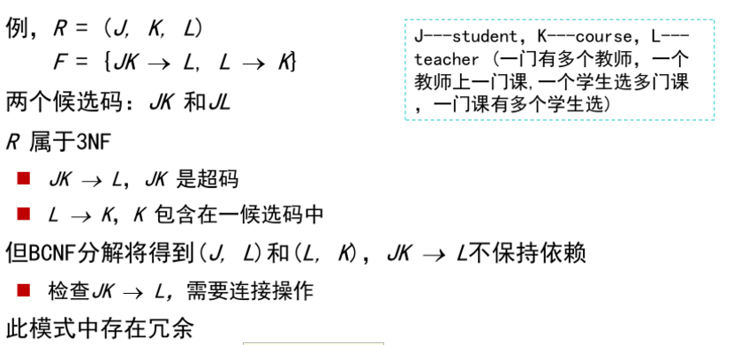
3NF Example

Slide 118
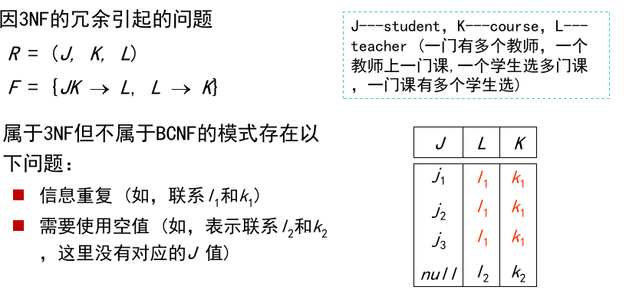
3NF Example

Slide 119
Testing for 3NF
Optimization: Need to check only FDs in F, need not check all FDs in F⁺.
Use attribute closure to check for each dependency α → β, if α is a superkey.
If α is not a superkey, we have to verify if each attribute in β is contained in a candidate key of R
  this test is rather more expensive, since it involve finding candidate keys
  testing for 3NF has been shown to be NP-hard
  Interestingly, decomposition into third normal form (described shortly) can be done in polynomial time

Slide 120
3NF Decomposition Algorithm
Let F_{c} be a canonical cover for F;//首先需要计算F的正则覆盖集F_{c}
i := 0; /*R₀ is null*/
for each functional dependency α → β in F_{c} do
if none of the schemas R_{j}, 1 ≤ j ≤ i contains α β
then begin
i := i + 1;
R_{i} := α β
end
if none of the schemas R_{j}, 1 ≤ j ≤ i contains a candidate key for R
then begin
i := i + 1;
R_{i} := any candidate key for R;
end
/* Optionally, remove redundant relations */
repeat
if any schema R_{j} is contained in another schema R_{k}
then /* delete R_{j} */
R_{j} = R;;
i=i-1;
return (R₁, R₂, ..., R_{i})
对每个α → β，作一个小关系R_{i} ，让α去作主。一箭一小表 法则 保证了dependency preserving
补关键字法则，
如果不冗余，关键字中所有属性作为一个小关系，
保证lossless -join

Slide 121
3NF Decomposition Algorithm (Cont.)
Above algorithm ensures:
  each relation schema R_{i} is in 3NF
  decomposition is dependency preserving and lossless-join
  Proof of correctness is at end of this presentation

Slide 122
3NF Decomposition: An Example
Schema Banker-info-schema =
  (branch-name, customer-name, banker-name, office-number)
  functional dependency set F is as follows
  banker-name → branch-name office-number
  customer-name branch-name → banker-name
Candidate key is {customer-name, branch-name}
This schema is not in 3NF, because banker-name is not superkey, and branch-name, office-number is not contained in the candidate key
Step0. There is no extraneous attributes in the two functional dependencies of F, so F_{c} = F
Step1. initially, i= 0, R₀ is null

Slide 123
3NF Decompsition Example (Cont.)
一箭一小表 法则，得两小表
Step2. the for loop in the algorithm results in the following schemas
R₁ = Banker-office-schema = (banker-name, branch-name,
office-number)
R₂ = Banker-schema = (customer-name, branch-name,
banker-name)
Step3. Since Banker-schema contains the candidate key {customer-name, branch-name} for Banker-info-schema, step3 in the algorithm do not proceeds
  /* 对R的候选健不必再处理*/
The decomposition result is Banker-office-schema and Banker-schema

Slide 124
3NF Decomposition Example 2
R={SNO，SD，Head，CNO，G}
  F={SNO→SD， SD→Head, SNO→Head, (SNO,CNO)→G} /*存在传递函数依赖*/
Candidate keys {SNO, CNO}
R is not in 3NF
  there is transitive FD SNO→Head, or
  SNO→SD does not satisfy 3NF definition

Slide 125
3NF Decomposition Example 2
Decomposition
  Step1. F_{C}={SNO→SD, SD→Head, (SNO,CNO)→G}
  Step2.
    R₁ = {SNO, SD}, F1={SNO→SD}
    R₂ = {SD, Head}, F2={SD →Head}
    R₃ = {SNO, CNO, G}, F3={(SNO,CNO)→G}
  Step3. candidate key {SNO, CNO} has been contained in R₃

Slide 126
3NF Decomposition Example 3
R(ABCDEG)
F = { D→G, CD→E, CE→D, E→D, A→B }
候选码: ACE, ACD
R₂包含ED
ρ={ }
R₁(DG)
, R₂(CDE)
{ CD→E,
E→D }
, R₃(AB)
, R₄(ACE)
Π_{Ri}(F):
{D→G}
{A→B}
{ }
候选码:
D
CD, CE
A
ACE
Step1: 求F的规范覆盖：删除CE→D
Step2: 初始化；
Step3: 逐个考察F中的每一个FD
Step4: 考察R的候选码： 加入ACE
R₂是3NF(全是主属性), 但不是BCNF(CE→D是部分依赖)
ρ显然保持依赖，请自己验证ρ是无损分解

Slide 127
Comparison of BCNF and 3NF
It is always possible to decompose a relation into a set of relations that are in 3NF such that:
  the decomposition is lossless
  the dependencies are preserved
It is always possible to decompose a relation into a set of relations that are in BCNF such that:
  the decomposition is lossless
  it may not be possible to preserve dependencies.

Slide 128
Design Goals
Goal for a relational database design is:
  BCNF.
  Lossless join.
  Dependency preservation.
If we cannot achieve this, we accept one of
  Lack of dependency preservation BCNF+有损
  Redundancy due to use of 3NF 3NF+冗余
Interestingly, SQL does not provide a direct way of specifying functional dependencies other than superkeys.
Can specify FDs using assertions, but they are expensive to test, (and currently not supported by any of the widely used databases!)
Even if we had a dependency preserving decomposition, using SQL we would not be able to efficiently test a functional dependency whose left hand side is not a key.

Slide 129
Design Goals
根据是否保持依赖、是否无损分解将分解分成四类：
无损分解 | 保持依赖 | 说明
YES | YES | 最好 (不丢失数据和依赖)
YES | NO | 可接受 (丢失依赖, 会导致异常)
NO | YES | 不能接受(丢失数据)
NO | NO | 不能接受(丢失数据和依赖)
问题：如何在保证无损和保持依赖的前提下，使分解所得的关系模式集符合尽可能高的范式？
目前有三个算法：
1. 保持依赖且无损地分解成3NF关系模式集
2. 无损地分解成BCNF关系模式集
3. 无损地分解成4NF关系模式集

Slide 130
判定范式的方法
给定关系模式和FD集，判断关系模式所属范式
解题步骤：
1）求候选码, 确定主属性和非主属性；
2）看是否有非平凡FD，其左部不含候选码；
3）若不存在，则是BCNF；
4）否则：若这些FD的右部都是主属性，则是3NF ；
5） 否则：若任何候选码的任何真子集都不确定非主
属性，则是2NF ；
6） 否则是1NF。
例：R(ABCD), F={AB→C, A→D },
候选码：AB; 主属性：A、B; 非主属性: C、D
A→D的左部不含候选码，R不是BCNF
A→D的右部含非主属性，R不是3NF
A→D：候选码的真子集确定非主属性 ， R不是2NF
因此，R是1NF

Slide 131
判定范式的方法
给定关系模式和FD集，判断关系模式所属范式
解题步骤：
1）求候选码, 确定主属性和非主属性；
2）看是否有非平凡FD，其左部不含候选码；
3）若不存在，则是BCNF；
4）否则：若这些FD的右部都是主属性，则是3NF ；
5） 否则：若任何候选码的任何真子集都不确定非主
属性，则是2NF ；
6） 否则是1NF。
例： R(ABCD), F={AB→C, C→D },
候选码：AB; 主属性：A、B; 非主属性: C、D
C→D的左部不含候选码，R不是BCNF
C→D的右部含非主属性，R不是3NF
候选码的任何真子集都不确定非主属性:
R是2NF
A→C, A→D, B→C, B→D

Slide 132
判定范式的方法
给定关系模式和FD集，判断关系模式所属范式
解题步骤：
1）求候选码, 确定主属性和非主属性；
2）看是否有非平凡FD，其左部不含候选码；
3）若不存在，则是BCNF；
4）否则：若这些FD的右部都是主属性，则是3NF ；
5） 否则：若任何候选码的任何真子集都不确定非主
属性，则是2NF ；
6） 否则是1NF。
例：R(BCDEGH), F={BCD→EGH, E→D,G→C },
候选码：BCD、BCE、BDG、BEG。
主属性: B、C、D、E、G; 非主属性: H
E→D, G→D的左部不含候选码，R不是BCNF
E→D, G→D的右部都是主属性， 所以R是3NF

Slide 133
8.6 Multivalued Dependencies
Suppose we record names of children, and phone numbers for instructors:
  inst_child(ID, child_name)
  inst_phone(ID, phone_number)
If we were to combine these schemas to get
  inst_info(ID, child_name, phone_number)
  Example data:
  (99999, David, 512-555-1234)
  (99999, David, 512-555-4321)
  (99999, William, 512-555-1234)
  (99999, William, 512-555-4321)
This relation is in BCNF Why?

Slide 134
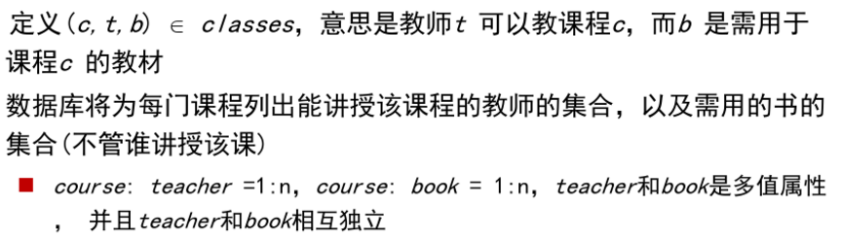
8.6 Multivalued Dependencies
There are database schemas in BCNF that do not seem to be sufficiently normalized
Consider a database
classes (course, teacher, book )

Slide 135
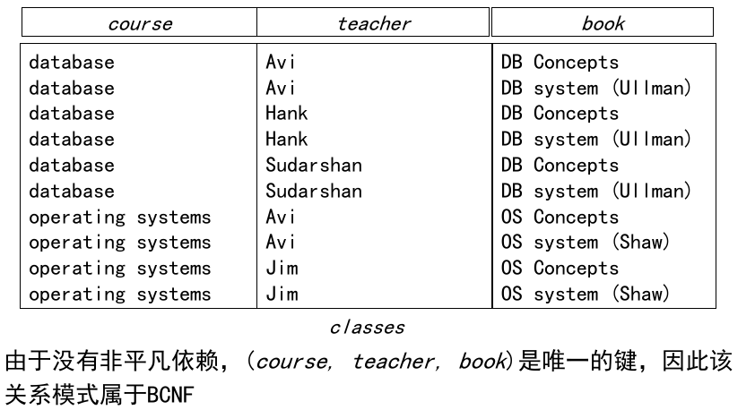
8.6 Multivalued Dependencies
新增加教师 Cooper 教 database,
可能插入两个记录（都合法，但操作麻烦，有歧义）
(database, Cooper, DB Concepts)
(database, Cooper, Ullman)

Slide 136
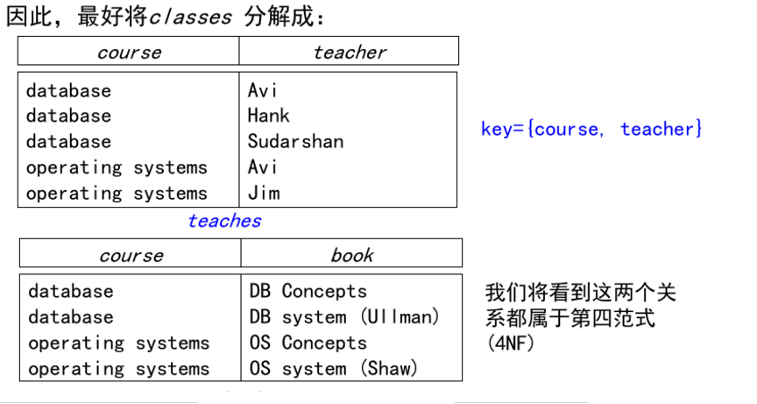
8.6 Multivalued Dependencies

Slide 137
Multivalued Dependencies (MVDs)
Let R be a relation schema and let α ⊆ R and β ⊆ R. The multivalued dependency
α →→ β
holds on R if in any legal relation r(R), for all pairs for tuples t₁ and t₂ in r such that t₁[α] = t₂ [α], there exist tuples t₃ and t₄ in r such that:
t₁[α] = t₂ [α] = t₃ [α] = t₄ [α]
t₃[β] = t₁ [β]
t₃[R – β] = t₂[R – β]
t₄ [β] = t₂[β]
t₄[R – β] = t₁[R – β]

Slide 138
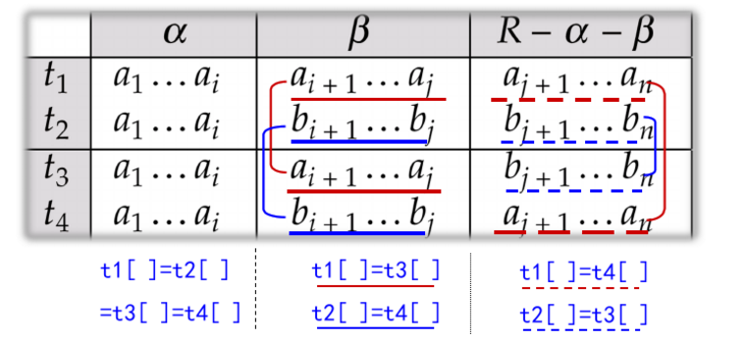
MVD (Cont.)
Tabular representation of α →→ β

Slide 139
MVD (Cont.)
设R(U)是一个属性集U上的一个关系模式， X、 Y和Z是U的子集，并且Z＝U－X－Y，多值依赖 X→→Y成立当且仅当对R的任一关系r，r在（X，Z）上的每个值对应一组Y的值，这组值仅仅决定于X值而与Z值无关
inst_info(ID, child_name, phone_number)
对于ID 的每一个值，child_name有一组值与之对应，而不论phone_number取何值

Slide 140
8.6 Multivalued Dependencies
多值依赖的定义
  对于R中每个在A上取值相同的元组对t和u，能找到满足下列条件的元组v：
    在A属性上的取值与t和u相同；
    在B属性上的取值与t相同；
    在AB外的其他所有属性上取值与u相同。
隐含：即包含了B与“其他”的所有取值组合。
  inst_info(ID, child_name, phone_number)
  (99999, David, 512-555-1234) t
  (99999, William, 512-555-4321)
  (99999, David, 512-555-4321) v
  (99999, William, 512-555-1234) v
  u

Slide 141
Example
Let R be a relation schema with a set of attributes that are partitioned into 3 nonempty subsets.
Y, Z, W
We say that Y →→ Z (Y multidetermines Z )
if and only if for all possible relations r (R )
< y₁, z₁, w₁ > ∈ r and < y₁, z₂, w₂ > ∈ r
then
< y₁, z₁, w₂ > ∈ r and < y₁, z₂, w₁ > ∈ r
Note that since the behavior of Z and W are identical it follows that
Y →→ Z if Y →→ W

Slide 142
Example (Cont.)
In our example:
ID →→ child_name (1:n)
ID →→ phone_number (1:n)
The above formal definition is supposed to formalize the notion that given a particular value of Y (ID) it has associated with it a set of values of Z (child_name) and a set of values of W (phone_number), and these two sets are in some sense independent of each other.
Note:
  If Y → Z then Y →→ Z
  Indeed we have (in above notation) Z₁ = Z₂
  The claim follows.

Slide 143
Use of Multivalued Dependencies
We use multivalued dependencies in two ways:
  1. To test relations to determine whether they are legal under a given set of functional and multivalued dependencies
  2. To specify constraints on the set of legal relations. We shall thus concern ourselves only with relations that satisfy a given set of functional and multivalued dependencies.
If a relation r fails to satisfy a given multivalued dependency, we can construct a relations r′ that does satisfy the multivalued dependency by adding tuples to r.

Slide 144
Theory of MVDs
From the definition of multivalued dependency, we can derive the following rule:
  If α → β, then α →→ β
That is, every functional dependency is also a multivalued dependency
The closure D⁺ of D is the set of all functional and multivalued dependencies logically implied by D.
  We can compute D⁺ from D, using the formal definitions of functional dependencies and multivalued dependencies.
  We can manage with such reasoning for very simple multivalued dependencies, which seem to be most common in practice
  For complex dependencies, it is better to reason about sets of dependencies using a system of inference rules (see Appendix C).

Slide 145
Fourth Normal Form
A relation schema R is in 4NF with respect to a set D of functional and multivalued dependencies if for all multivalued dependencies in D⁺ of the form α →→ β, where α ⊆ R and β ⊆ R, at least one of the following hold:
  α →→ β is trivial (i.e., β ⊆ α or α ∪ β = R)
  α is a superkey for schema R
If a relation is in 4NF it is in BCNF

Slide 146
Restriction of Multivalued Dependencies
The restriction of D to R_{i} is the set D_{i} consisting of
  All functional dependencies in D⁺ that include only attributes of R_{i}
  All multivalued dependencies of the form
    α →→ (β ∩ R_{i})
  where α ⊆ R_{i} and α →→ β is in D⁺

Slide 147
4NF Decomposition Algorithm
result: = {R};
done := false;
compute D⁺;
Let D_{i} denote the restriction of D⁺ to R_{i}
while (not done)
if (there is a schema R_{i} in result that is not in 4NF) then
begin
let α →→ β be a nontrivial multivalued dependency that holds
on R_{i} such that α → R_{i} is not in D_{i}, and α∩β=φ;
result := (result - R_{i}) ∪ (R_{i} - β) ∪ (α, β);
end
else done:= true;
Note: each R_{i} is in 4NF, and decomposition is lossless-join

Slide 148
Example
R =(A, B, C, G, H, I)
F ={ A →→ B
B →→ HI
CG →→ H }
R is not in 4NF since A →→ B and A is not a superkey for R
Decomposition
a) R₁ = (A, B) (R₁ is in 4NF)
b) R₂ = (A, C, G, H, I) (R₂ is not in 4NF, decompose into R₃ and R₄)
c) R₃ = (C, G, H) (R₃ is in 4NF)
d) R₄ = (A, C, G, I) (R₄ is not in 4NF, decompose into R₅ and R₆)
  A →→ B and B →→ HI ➔ A →→ HI, (MVD transitivity), and
  and hence A →→ I (MVD restriction to R₄)
e) R₅ = (A, I) (R₅ is in 4NF)
f)R₆ = (A, C, G) (R₆ is in 4NF)

Slide 149
Further Normal Forms
Join dependencies generalize multivalued dependencies
  lead to project-join normal form (PJNF) (also called fifth normal form)
A class of even more general constraints, leads to a normal form called domain-key normal form.
Problem with these generalized constraints: are hard to reason with, and no set of sound and complete set of inference rules exists.
Hence rarely used

Slide 150
Overall Database Design Process
We have assumed schema R is given
  R could have been generated when converting E-R diagram to a set of tables.
  R could have been a single relation containing all attributes that are of interest (called universal relation).
  Normalization breaks R into smaller relations.
  R could have been the result of some ad hoc design of relations, which we then test/convert to normal form.

Slide 151
ER Model and Normalization
When an E-R diagram is carefully designed, identifying all entities correctly, the tables generated from the E-R diagram should not need further normalization.
However, in a real (imperfect) design, there can be functional dependencies from non-key attributes of an entity to other attributes of the entity
  Example: an employee entity with attributes
  department_name and building,
  and a functional dependency
  department_name→ building
  Good design would have made department an entity
Functional dependencies from non-key attributes of a relationship set possible, but rare --- most relationships are binary

Slide 152
Denormalization for Performance
May want to use non-normalized schema for performance
For example, displaying prereqs along with course_id, and title requires join of course with prereq
Alternative 1: Use denormalized relation containing attributes of course as well as prereq with all above attributes
  faster lookup
  extra space and extra execution time for updates
  extra coding work for programmer and possibility of error in extra code
Alternative 2: use a materialized view defined as
course prereq
  Benefits and drawbacks same as above, except no extra coding work for programmer and avoids possible errors

Slide 153
Other Design Issues
Some aspects of database design are not caught by normalization
Examples of bad database design, to be avoided:
Instead of earnings (company_id, year, amount ), use
  earnings_2004, earnings_2005, earnings_2006, etc., all on the schema (company_id, earnings).
    Above are in BCNF, but make querying across years difficult and needs new table each year
  company_year (company_id, earnings_2004, earnings_2005,
  earnings_2006)
    Also in BCNF, but also makes querying across years difficult and requires new attribute each year.
    Is an example of a crosstab, where values for one attribute become column names
    Used in spreadsheets, and in data analysis tools

Slide 154
Modeling Temporal Data
Temporal data have an association time interval during which the data are valid.
A snapshot is the value of the data at a particular point in time
Several proposals to extend ER model by adding valid time to
  attributes, e.g., address of an instructor at different points in time
  entities, e.g., time duration when a student entity exists
  relationships, e.g., time during which an instructor was associated with a student as an advisor.
But no accepted standard
Adding a temporal component results in functional dependencies like
ID → street, city
not to hold, because the address varies over time
A temporal functional dependency X → Y holds on schema R if the functional dependency X → Y holds on all snapshots for all legal instances r (R).
⧫

Slide 155
Modeling Temporal Data (Cont.)
In practice, database designers may add start and end time attributes to relations
  E.g., course(course_id, course_title) is replaced by
    course(course_id, course_title, start, end)
    Constraint: no two tuples can have overlapping valid times
      Hard to enforce efficiently
Foreign key references may be to current version of data, or to data at a point in time
  E.g., student transcript should refer to course information at the time the course was taken

Slide 156
End of Chapter

Slide 157
Proof of Correctness of 3NF Decomposition Algorithm

Slide 158
Correctness of 3NF Decomposition Algorithm
3NF decomposition algorithm is dependency preserving (since there is a relation for every FD in F_{c})
Decomposition is lossless
  A candidate key (C ) is in one of the relations R_{i} in decomposition
  Closure of candidate key under F_{c} must contain all attributes in R.
  Follow the steps of attribute closure algorithm to show there is only one tuple in the join result for each tuple in R_{i}

Slide 159
Correctness of 3NF Decomposition Algorithm (Cont’d.)
Claim: if a relation R_{i} is in the decomposition generated by the
above algorithm, then R_{i} satisfies 3NF.
Let R_{i} be generated from the dependency α → β
Let γ → B be any non-trivial functional dependency on R_{i}. (We need only consider FDs whose right-hand side is a single attribute.)
Now, B can be in either β or α but not in both. Consider each case separately.

Slide 160
Correctness of 3NF Decomposition (Cont’d.)
Case 1: If B in β:
  If γ is a superkey, the 2nd condition of 3NF is satisfied
  Otherwise α must contain some attribute not in γ
  Since γ → B is in F⁺ it must be derivable from F_{c}, by using attribute closure on γ.
  Attribute closure not have used α →β. If it had been used, α must be contained in the attribute closure of γ, which is not possible, since we assumed γ is not a superkey.
  Now, using α→ (β- {B}) and γ → B, we can derive α →B
  (since γ ⊆ α β, and B ∉ γ since γ → B is non-trivial)
  Then, B is extraneous in the right-hand side of α →β; which is not possible since α →β is in F_{c}.
  Thus, if B is in β then γ must be a superkey, and the second condition of 3NF must be satisfied.

Slide 161
Correctness of 3NF Decomposition (Cont’d.)
Case 2: B is in α.
  Since α is a candidate key, the third alternative in the definition of 3NF is trivially satisfied.
  In fact, we cannot show that γ is a superkey.
  This shows exactly why the third alternative is present in the definition of 3NF.
Q.E.D.

Slide 162
Figure 8.02

Slide 163

Figure 8.03

Slide 164
Figure 8.04

Slide 165

Figure 8.05

Slide 166
Figure 8.06

Slide 167

Figure 8.14

Slide 168

Figure 8.15

Slide 169

Figure 8.17

